Slide 1
Introducing M3G
April 3, 2007

Slide 2
Last Class…
Mobile 3D graphics history.
Khronos group that started M3G standardization.
Design principles for standardization.
OpenGL ES.
M3G.

Slide 3
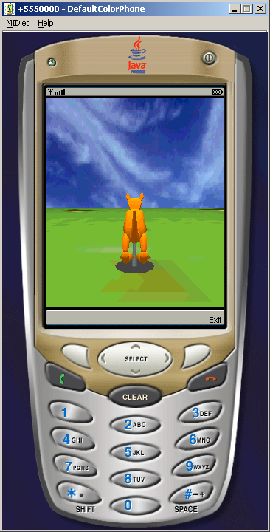
Last Class…

Slide 4
Intro
Growing subset of mobile phones come preinstalled with M3G.
To get a hold of one, just pick up for example, any Nokia/Sony Ericsson phone with quarter VGA display (240 X 320 pixels).

Slide 5
This Lecture
Will introduce M3G, put in the context of mobile Java environment, OpenGL ES ad other scene graph engines.
Subsequent classes will cover M3G programming concepts.

Slide 6
Overview of M3G
Mobile 3D Graphics API providing Java developers with efficient, compact API for managing and rendering 3D scenes.
Based on established OpenGL rendering pipeline, yet designed for Java with OO principles.
Shallow learning curve for beginners and high productivity for seasoned 3D programmers.

Slide 7
Overview of M3G
Retained- mode design
Programming style for 3D graphics where a
persistent representation of graphical
objects, their spatial relationships,
appearance and position of viewer is held in
memory.
Programmers does more high-level functions than
low-level work.

Slide 8
Overview of M3G
Java applications (MIDlets)
M3G
MIDP
Other JSRs
OpenGL ES
VM (CLDC/CDC)

Slide 9
M3G: Features and Structure
Object Oriented interface to OpenGL ES at the low-level, and a link to Digital Content Creation (DCC) tools at the high level.
DCC tools include 3D modeling and animation tools.

Slide 10
M3G: Class Hierarchy
Classes defined in package javax.microedition.m3g.
Base class of hierarchy is Object3D.
All objects that can be rendered or be part of a scene graph are derived from it. These objects are called scene graph objects.
Four classes not derived from Object3D:
  Graphics3D: takes care of all rendering.
  Loader: Importing art assets from files.
  Transform: represents a 4X4 matrix.
  RayIntersection: Used for picking objects in a scene.

Slide 11
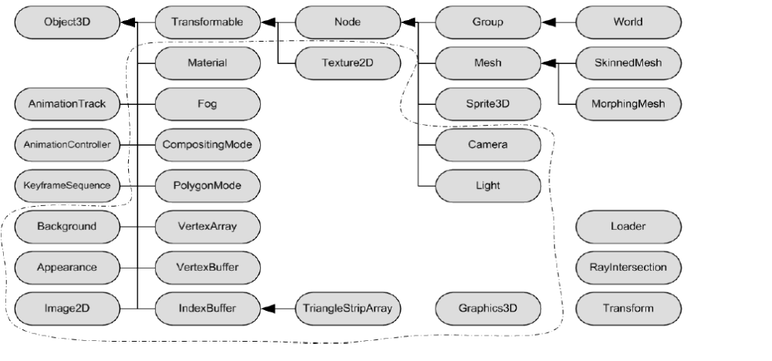
Notes:
The dotted lines are used to demarkate classes that are simple wrappers to OpenGL.

Slide 12
Creating a Scene Graph
Retained-mode components linked together to form complete objects, groups of objects, and finally an entire scene.
Scene graph supports nodes like Camera, Light, Group, Mesh (rigid-body).
In addition, there are two deformable variants of Mesh: SkinnedMesh and MorphingMesh.
Setup complete scene graph in the beginning and make minor changes to it on a per-frame basis.
Reduces amount of Java code executed; more efficient.

Slide 13
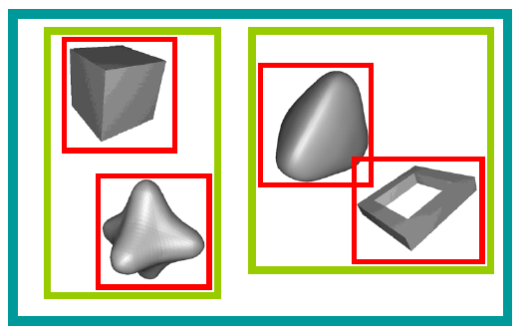
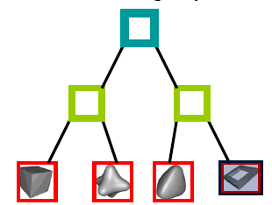
2D Space
3D Scene Graph

Slide 14
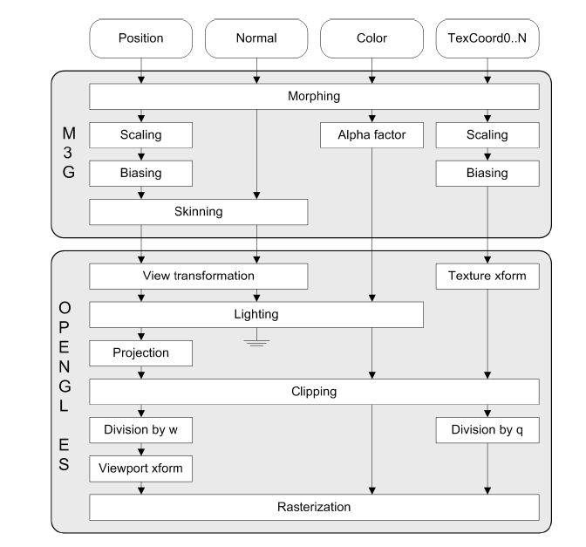
Transformation and Lighting Pipeline

Slide 15
M3G’s Keyframe Animation Engine
Can animate any property of any object by sampling a user-defined animation curve.
Allows any arbitrary animation curve to be exported from DCC tools.
Decoupled from rendering; first apply predefined animations and then render scene.
Composed of three classes:
  KeyFrameSequence: Stores the actual keyframes, specifies the interpolation mode and whether the sequence is looping or not.
  AnimationController: Defines speed of animation as world time.
  AnimationTrack:Links together keyframe sequence, animation controller and target object.

Slide 16
Hello World!
Code is the shortest, fully functional M3G animation player.
MIDlet loads complete scene from .m3g file, animates and renders at maximum frame rate until user presses exit key.

Slide 17
World world = (World)Loader.load("/res/world.m3g")[0];
Graphics graphics = getGraphics();
Graphics3D g3d = Graphics3D.getInstance();
long start = System.currentTimeMillis();
for (int time=0; getKeyStates()==0; ) {
long time = System.currentTimeMillis() - start;
world.animate(time);
g3d.bindTarget(graphics);
g3d.render(world);
g3d.releaseTarget();
flushGraphics();
Thread.yield();
Animate using wall-clock time so that animation does not fast-forward if device is too fast.
Update animations in the scene to the current time.
Bind frame buffer (graphics object is a handle to the frame buffer) to Graphics3D.
Render each frame.
Release the frame buffer.
Flushing it to screen
Give other threads in system to do their job.

Slide 18
In-Class Exercise
Try Lec18 example on your emulator and phone with the different m3g files.

Slide 19
Design Principles and Conventions
A system that is small, fast, easy to use by both novices and experts.
Work the same way for all devices except for a few unavoidable performance differences.

Slide 20
1. High Abstraction Level
To compensate for the Java performance overhead by building in more functionality.
Closer match with modeling tools.
Less fragmented platform by abstracting the underlying renderer.

Slide 21
2. No Events or Callbacks
No interfaces, event handlers or abstract classes that the application could implement; kind of like programming in C.
All methods are fully synchronous. So when you call a method you regain control only after the method completes or throw an exception.
No M3G methods will block waiting for system resources; Never goes into deadlock.
Callbacks are eliminated to prevent instability and insecurity.

Slide 22
3. Robust Arithmetic
All scene graph operations and vertex transformations done at full dynamic range.
Full dynamic range is equivalent to 24-bit floating point format with 7 bits of exponent, 16 bits of mantissa and one sign bit.
Even if no FPU is available, you an use custom floating point representations storing for example mantissas and exponents separately.
Color operations in the pixel pipeline clamped to [0,1].

Slide 23
4. Consistent Methods
30 classes with around 400 methods and enumerations in M3G API.
Few methods consist of a single verb: animate, align, render, clear, load, etc. that do almost all the work.
Vast majority of methods are ‘getters’ and ‘setter.’
Also some ‘adders’ and ‘removers’ (Eg: addChild, removeChild)

Slide 24
5. Parameter Passing
Int, float and other primitive types passed by value.
Scene graph objects (derived from Object3D) copies by reference.
All other objects copied by value.

Slide 25
6. Numeric Values
Default numeric formats are float and int.
Images and vertices handled differently.
Pixels are fed into Image2D in byte arrays; one byte per color component (RGBA).
Colors passed in to setters are packed in integers in the 0xAARRGGBB order.
Vertex attributes in VertexArray are read/written in either byte or short arrays.

Slide 26
7. Enumerations
As Java has no support for enumerations, they are represented as constant integer values (i.e. static final int).
If you need a particular enumeration very often, you can copy into a local variable:
int REPEAT = Texture2D.WRAP_REPEAT;
myTexture1.setWrapping(REPEAT, REPEAT);
myTexture2.setWrapping(REPEAT, REPEAT);

Slide 27
9. Error Handling
Based on built-in exception mechanism.
Eg: ArithmeticException,IllegalStateException.
M3G more stringent about error-checking than OpenGL ES.
Makes debugging easier.

Slide 28
M3G 1.1
To combat market fragmentation, upgrade cycle of M3G is relatively slow.
Released June 2005, 1.5 years after M3G 1.0.
Focused on improving performance and interoperability of existing functionality.

Slide 29
Change 1: Pure 3D Rendering
Addition of the OVERWRITE hint.
Tells the implementation that you intend to do full-screen 3D rendering sp any pre-existing content may be discarded.

Slide 30
Change 2: PNG and JPEG Loading
M3G 1.1 supports PNG images with transparency information.
Support for JPEG images is optional for fear of risking royalty-free status.

Slide 31
Change 3: New ‘Getters’
AnimationController:
int getRefWorldTime()
Graphics3D:
Object getTarget()
boolean isDepthBufferEnabled()
int getHints()
int getViewportX()
int getViewportY()
int getViewportWidth()
int getViewportHeight()
float getDepthRangeNear()
float getDepthRangeFar()
Camera getCamera()
int getLightCount()
Light getLight(int index, Transform transform)

Slide 32
IndexBuffer:
int getIndexCount()
void getIndices(int[] indices)
KeyframeSequence:
int getComponentCount()
int getKeyframeCount()
int getInterpolationType()
int getKeyframe(int index, float[] value)
int getValidRangeFirst()
int getValidRangeLast()
Node:
int getAlignmentTarget(int axis)
Node getAlignmentReference(int axis)
PolygonMode:
boolean isLocalCameraLightingEnabled()
boolean isPerspectiveCorrectionEnabled()

Slide 33
SkinnedMesh:
void getBoneTransform(Node bone, Transform transform)
int getBoneVertices(Node bone, int[] indices, float[] weights)
Texture2D:
int getLevelFilter()
int getImageFilter()
VertexArray:
int getVertexCount()
int getComponentCount()
int getComponentType()
void get(int firstVertex, int numVertices, byte[] values)
void get(int firstVertex, int numVertices, short[] values)

